Slide 1
USE FIREBASE DATABASE TO STORE PHONE CONTACTS
ITAS 274 -Internet Programming III
Final Project
Minh Trung. Duong
(April 2021)

Slide 2
1. Firebase Realtime Database
A cloud hosted database that supports multiple platforms
All the data is stored in JSON format and any changes in data, reflects immediately
CRUD is the 4 operations that are indispensable for every application with Database interaction.

Slide 3
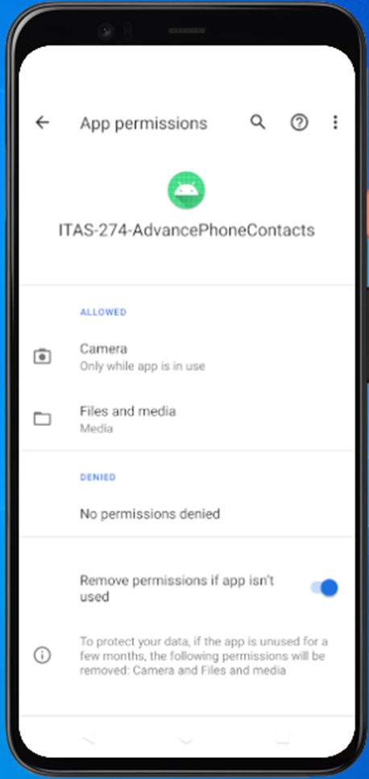
2. Requirements of the application
Android operating system version 7.0 or higher.
have camera and free memory.
The Application are allowed to use the camera and memory.
connected to the internet.

Slide 4
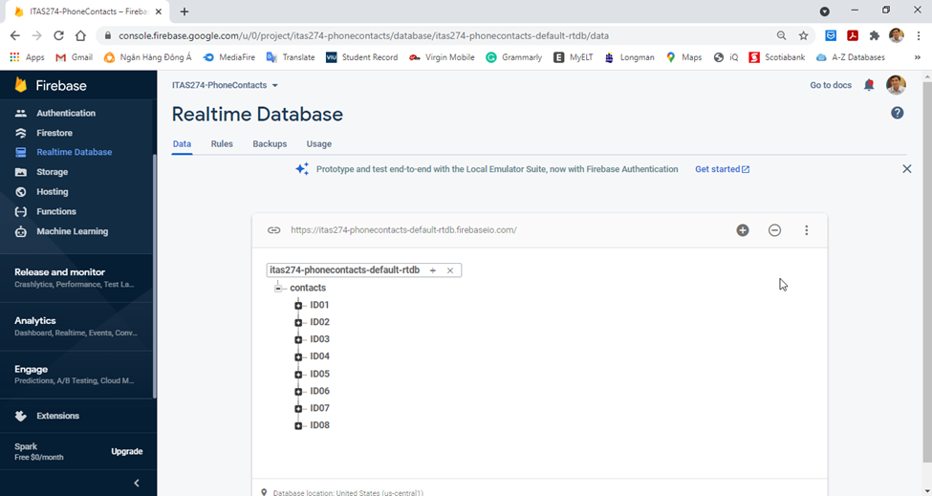
3. Create Realtime Database
Realtime database: ITAS247-phonecontacts

Slide 5
4. Interface design
The main screen, the application lists all the contacts that were previously saved. A contact includes: ID, name, email, phone number, and an image.
Two other interfaces, the interface of adding a new contact and editing an existing contact

Slide 6
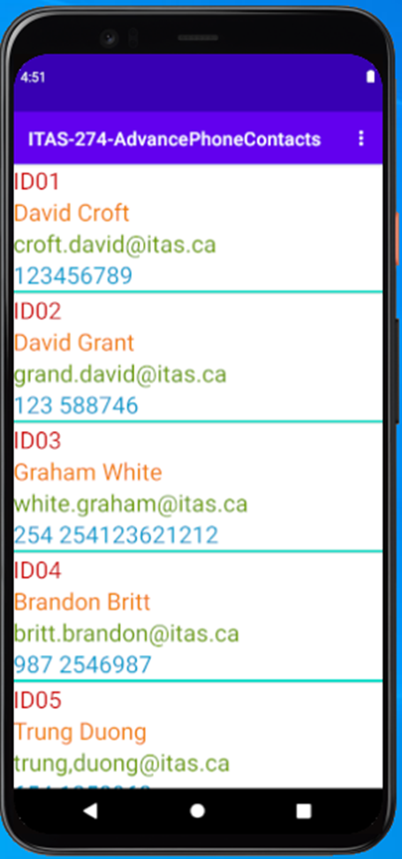
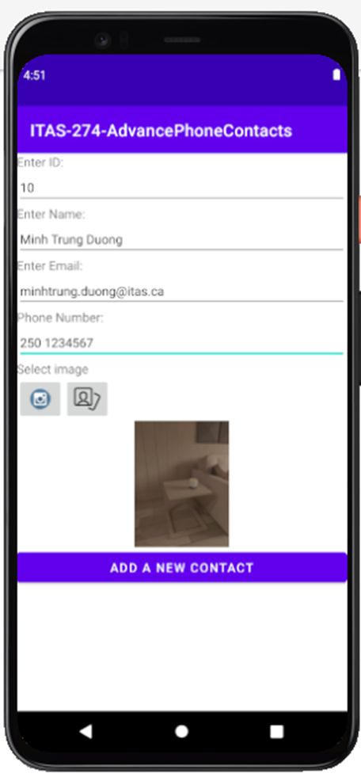
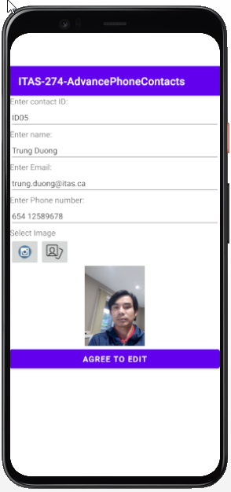
4. Interface design
The main screen
The adding a new contact layout
The Edit a new contact layout

Slide 7
5. Delete a contact
To delete a contact click and hold for a short time (2-3 seconds), the contact will be deleted and displays a toast "The contact has deleted successfully!"

Slide 8
Reference
Use file metadata with Cloud Storage on Android, Firebase, 2021,
<https://firebase.google.com/docs/storage/android/upload-files?authuser=1>
Thanks!

